Slide 1


PROGRAMMABLE LOGIC CONTROLLERS
APPLICATION OF PLC IN ELEVATOR DESIGN
02-07-2020

Slide 2
1. Total Inputs / Outputs
Inputs
Outputs
X0 Start button
X1 Stop button
X14 open button
X15 close button
Y0 Motor up
Y1 Motor down
Y2 open door motor
Y3 close door motor
Y4 floor 1 led
Y5 floor 2 led
Y6 floor 3 led
Y7 floor 4 led
Y10 go up led
Y11 go down led
X2 call up floor 1
X3 call up floor 2
X4 call up floor3
X20 door open limit switch
X21 door close limit switch
X22 floor 1 limit switch
X23 floor 2 limit switch
X24 floor 3 limit switch
X25 floor 4 limit switch
X5 call down floor 2
X6 call down floor 3
X7 call down floor 4
X10 cabin floor 1 button
X11 cabin floor 2 button
X12 cabin floor 3 button
X13 cabin floor 4 button

Slide 3
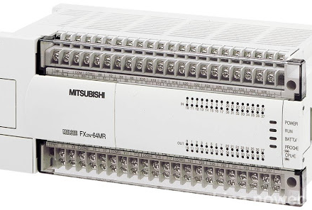
PLC Control FX2N-64MR

Slide 4
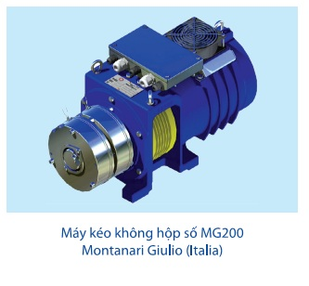
Main motor for pull/release the cabin

Slide 5
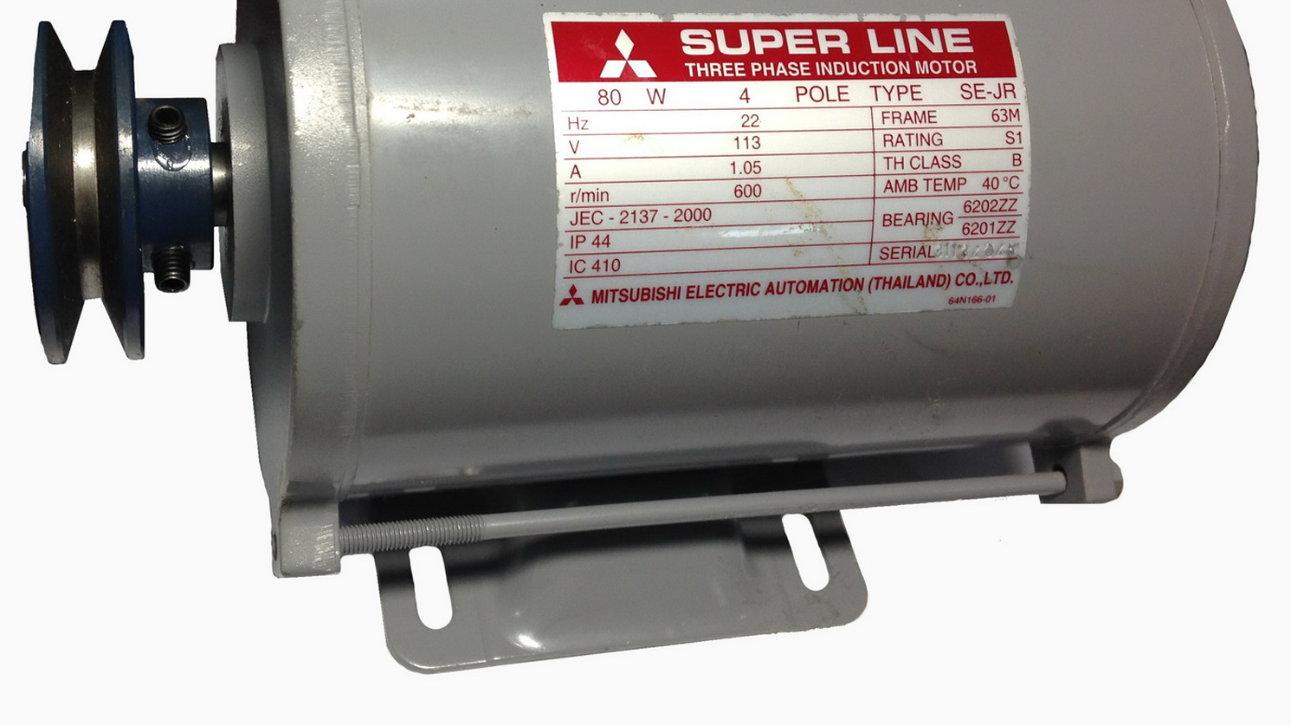
Open/close door motor

Slide 6
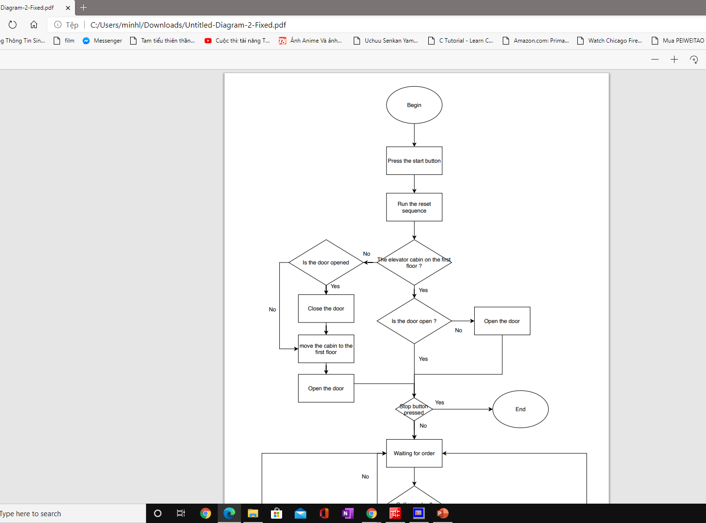
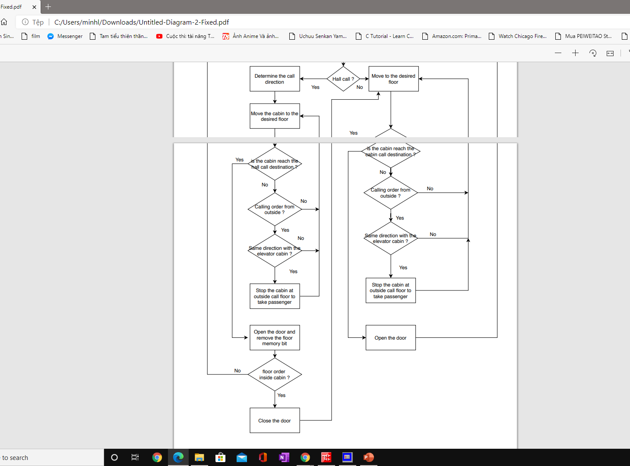
2. Principle diagram of elevator operation

Slide 7
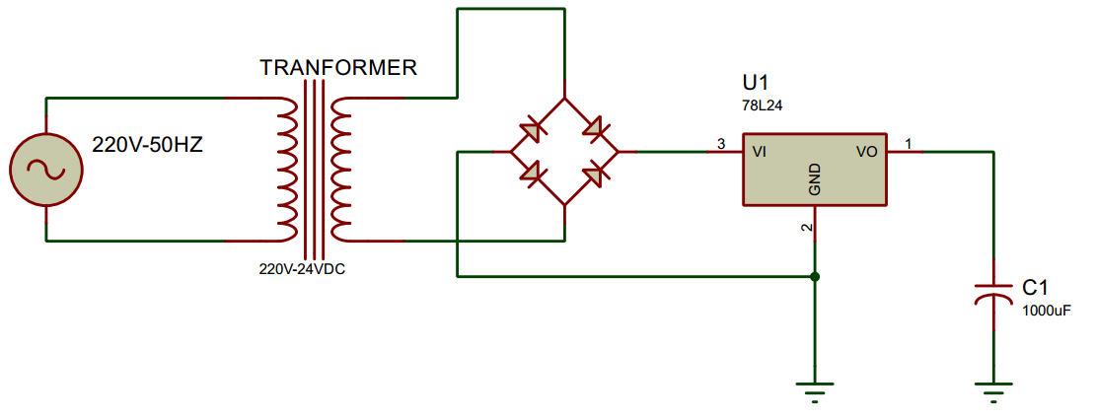
3. Wiring diagram
3.1. Transformer

Slide 8
3. Wiring diagram
3.2. Dynamic circuits

Slide 9
4. Simulation in GX Works 2

Slide 10
Do you have any questions?

Slide 11

Trần Tiểu Bình
Lâm Hùng Minh
Cao Tri Thức
Đặng Minh Quân

Slide 12


